Slide 1



Driving Fuel Economy
By Matthew Lane

Slide 2

Goals
Examine different metrics and their effects on fuel economy.
Evaluate how mechanical differences, transmission, and accessories can impact fuel consumption.
Data Source: https://www.kaggle.com/datasets/epa/fuel-economy

Slide 3
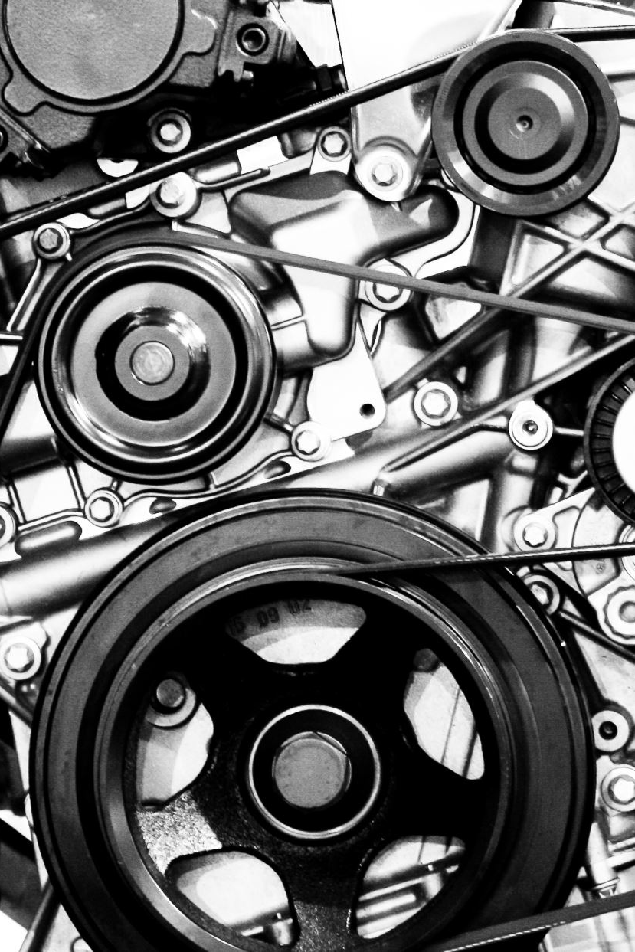
Options Tested
Does adding a turbocharger to your vehicle increase its miles per gallon?
Is there an annual difference between annual diesel fuel costs and premium fuel costs on personal vehicles? How significant is it if one exists?
What type of transmission (Auto or Manual) consumes more fuel annually?
Data Source: https://www.kaggle.com/datasets/epa/fuel-economy

Slide 4
With 95% confidence we can see that adding a turbocharger increases vehicle highway fuel miles per gallon by 2.53 MPG.
Data Source: https://www.kaggle.com/datasets/epa/fuel-economy

Slide 5
With the same confidence interval as before, the result of our testing shows that diesel engine vehicles have a significantly lower annual fuel cost than a vehicle requiring premium unleaded.
Data Source: https://www.kaggle.com/datasets/epa/fuel-economy

Slide 6
With our data on transmissions, we can conclude that the average automatic transmission consumes more barrels of fuel annually than a manual transmission with 95% confidence.
1 Barrel = 42 US Gallons
Data Source: https://www.kaggle.com/datasets/epa/fuel-economy
Note: Axis does not begin at zero here

Slide 7

Wrapping Up
We looked at how certain options can influence fuel consumption and fuel costs. We observed that adding a turbocharger to your vehicle can increase its highway MPG, that a diesel engine results in a lower annual fuel cost, and that manual transmissions consume less fuel than automatics on average.
A few other things we could explore is vehicle sizes and their impacts on efficiency, is there a viable difference between auto makes in the same class, and does the decade it comes from have a significant impact on fuel efficiency.
Data Source: https://www.kaggle.com/datasets/epa/fuel-economy

